Slide 1
Why Sites Matter in 2020
September 22, 2020

Slide 2
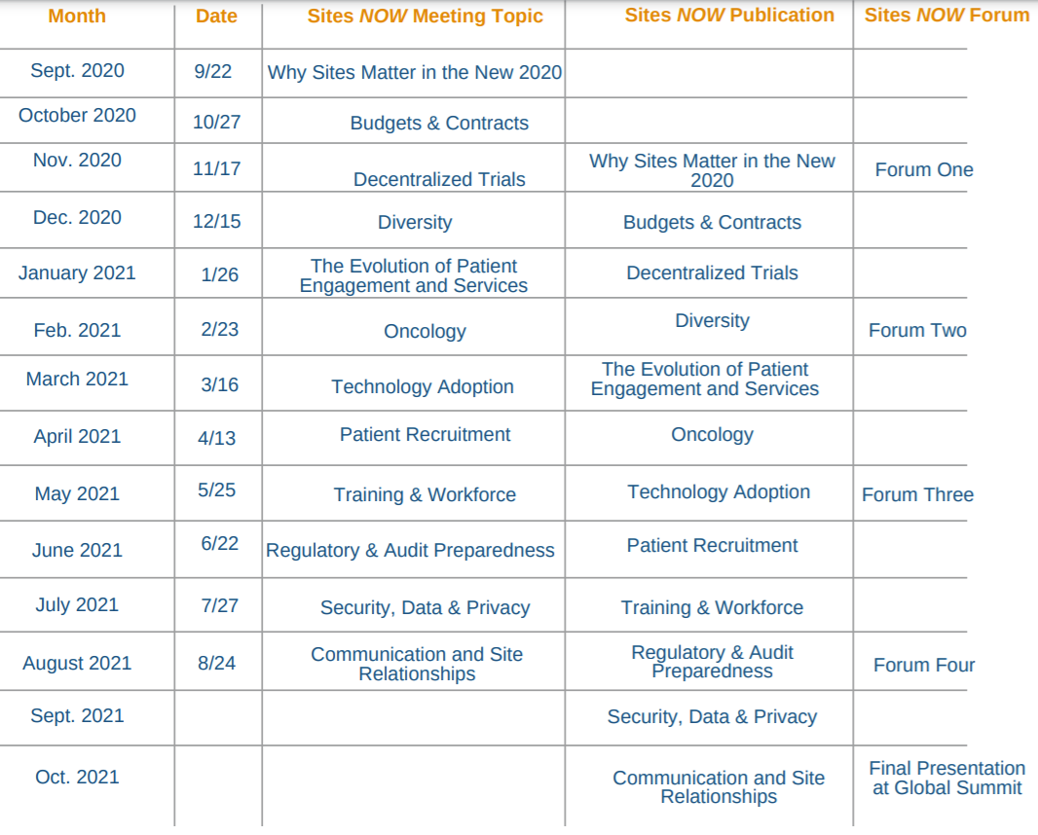

Slide 5
Ground Rules

Slide 6
Agenda
11:30-noon Intro and main presentation
Noon-1 Coffee Break Meet-ups and Team Breakouts
1-1:30 Team reporting in main room
Next Sites NOW (Tuesday 10/27 at 11:30am EST)

Slide 7
Sites NOW Pharmaceutical Supporters
List current as of 21 Sept 2020

Slide 8
Sites NOW CRO Supporters
List current as of 21 Sept 2020

Slide 9
Sites NOW Solution Provider Supporters
List current as of 21 Sept 2020

Slide 10
David Vulcano
Vice President, Research Compliance & Integrity, HCA Healthcare
Member, SCRS Leadership Council
Inaugural Recipient, Christine K. Pierre Site Impact Award

Slide 11
Faculty Disclosure
In compliance with ACCME Guidelines, I hereby declare:
I do not have financial or other relationships with the manufacturer(s) of any commercial services(s) discussed in this educational activity.
David Vulcano

Slide 12
What is a Site According to ICH-E6 (GCP)?
“Trial Site: The location(s) where trial-related activities are actually conducted.”
“Investigator: A person responsible for the conduct of the clinical trial at a trial site. If a trial is conducted by a team of individuals at a trial site, the investigator is the responsible leader of the team and may be called the principal investigator.”

Slide 13
Reporting Flow = Traditional “Single” Location
Data / Responsibility / Etc
Vulcano Clinical Research, LLC
Including:
CRO(s)
Central Lab(s)
Tech Supplier(s)
Media Companies
Etc.

Slide 14
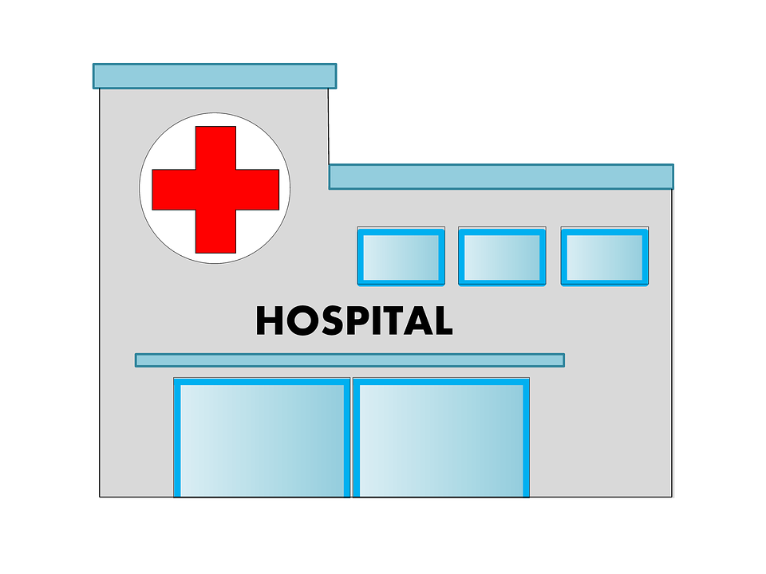
Was it really a “Single Location”?
Data / Responsibility / Etc
Data / Responsibility / Etc
Data / Responsibility / Etc
Vulcano Clinical Research, LLC
Including:
CRO(s)
Central Lab(s)
Tech Supplier(s)
Media Companies
Etc.
Community Hospital, Inc.
Medical Clinic, PLLC

Slide 15
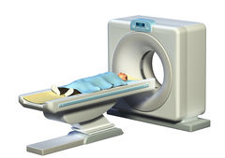
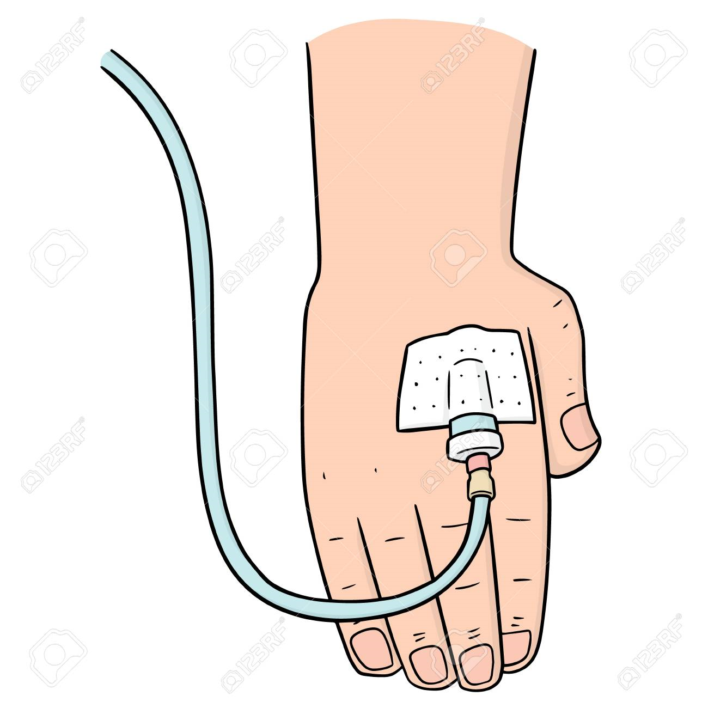
Adding Multiple “Non-Medical” Locations

Slide 16
Reporting Flow = Sponsor Centric?
Data
Data / Responsibility / Etc
Data / Responsibility / Etc

Slide 17
Reporting Flow = Primary Site Centric?
Data
Data / Responsibility / Etc
Data / Responsibility / Etc

Slide 18
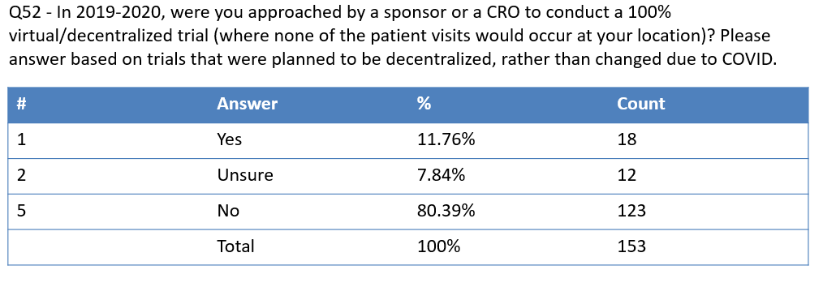
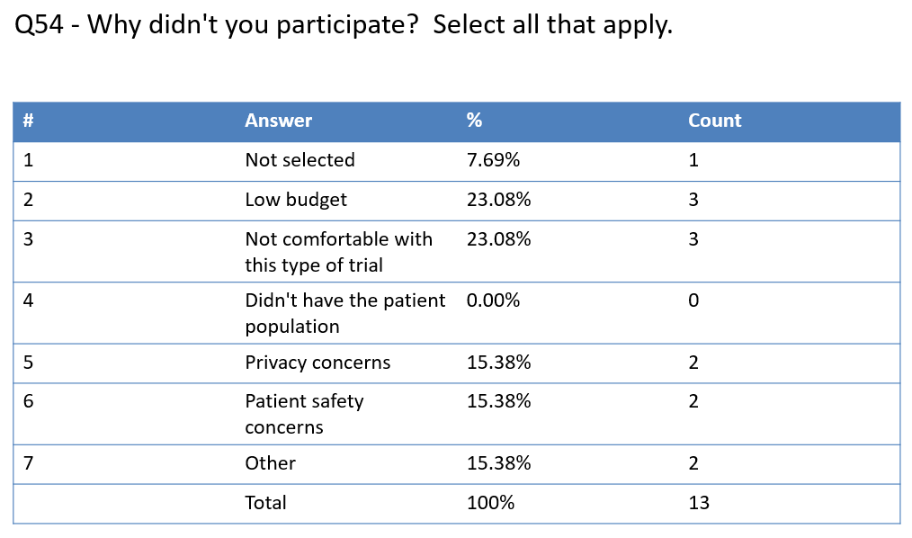
Not Yet Published Data from SCRS Site Survey

Slide 19
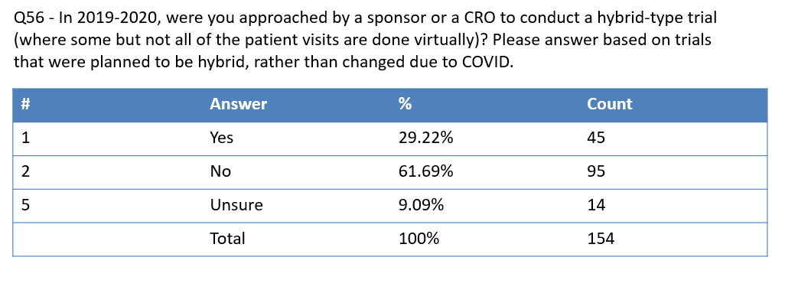
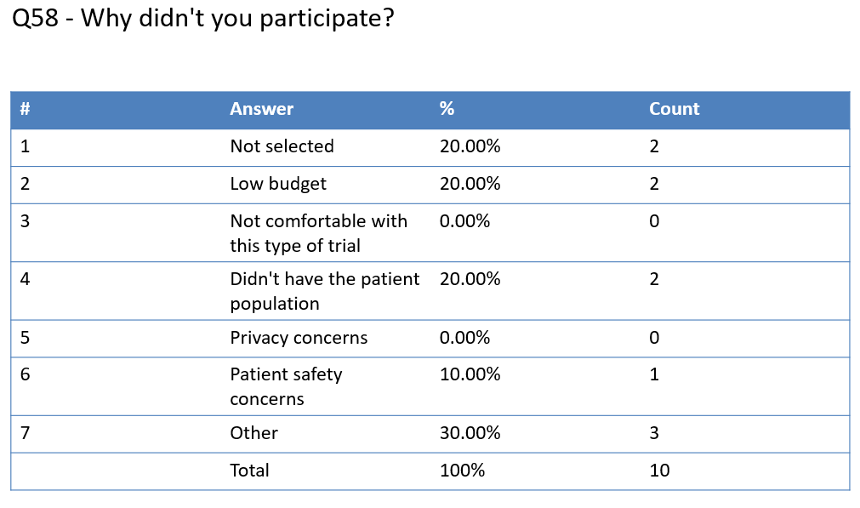
Not Yet Published Data from SCRS Site Survey

Slide 20
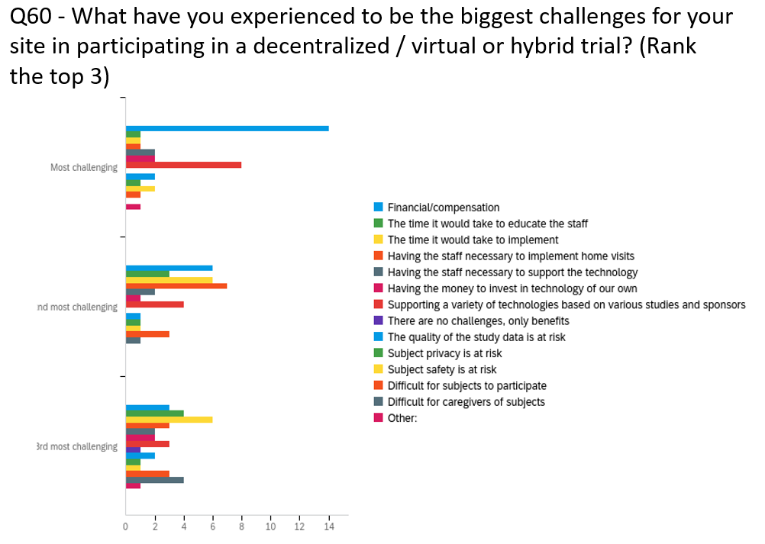
Not Yet Published Data from SCRS Site Survey

Slide 21
Why Professional Sites (Still) Matter…To Sponsors/CROs
Protocol Feasibility
Subject Population
Study Execution
Operations
Technology
More “hands on” adverse event assessments
Source of volunteers not amenable to DTC advertisement
Understanding the local diversity and how local inclusion works
Entry level onramp to the Clinical Research Professional workforce
Other reasons

Slide 22
Why Professional Sites (Still) Matter…To Communities
Knowledge resource on experimental care options
A place for providers to refer patients to
Knowledge resource on experimental care regulations
Already experienced with “new” therapeutics
A positive local economic impact (i.e. business, employer, contractor physician-recruiter etc).
Other reasons

Slide 23
Why Professional Sites (Still) Matter…To Patients/Subjects
(Oftentimes) Pre-existing personal relationship with patients
Single point of contact and (usually) local to the patients
Local knowledge and context in patient relations
Best source for “protocol-compliant” routine medical services
A safe place to go!
Other reasons

Slide 24
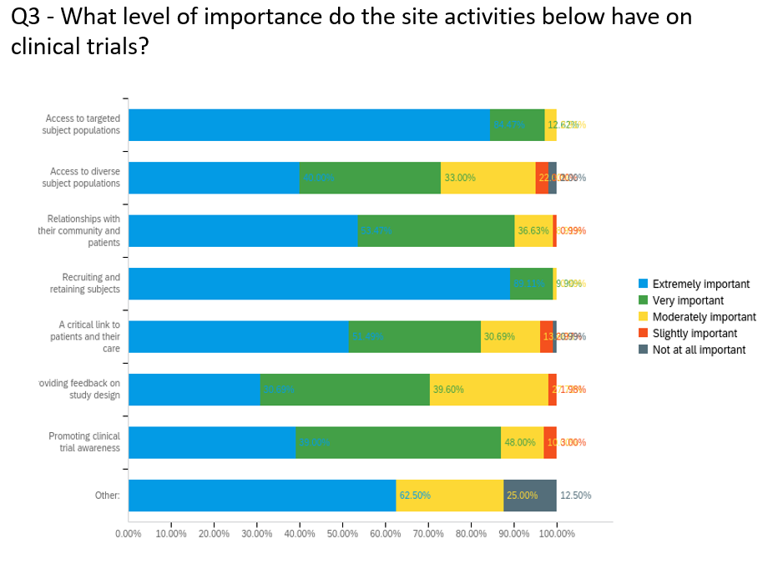
Not Yet Published Data from SCRS Site Survey

Slide 25
What are your thoughts?
Teams
Annapolis
Columbus
Jacksonville
Rockaway
Hellos and Get to Knows
Discuss why sites matter and how SCRS can help share this message across industry

